Slide 1
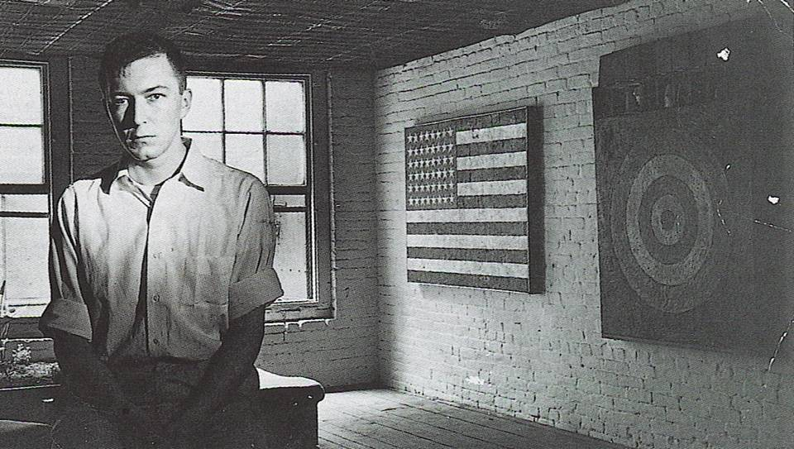
JASPER JOHNS
Born May 15, 1930 in Augusta, Georgia

Slide 2
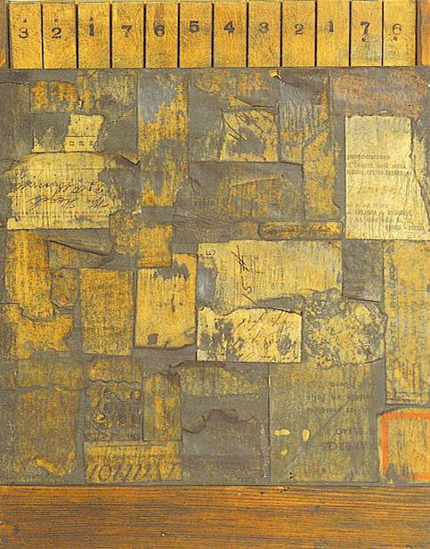
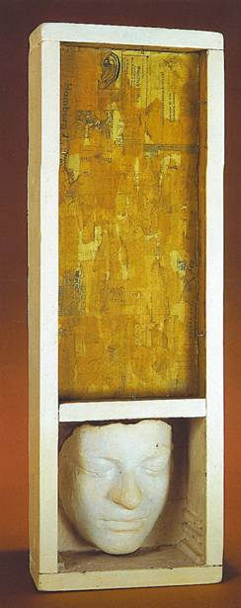
Construction with toy piano, 1954
Untitled, 1954

Slide 3
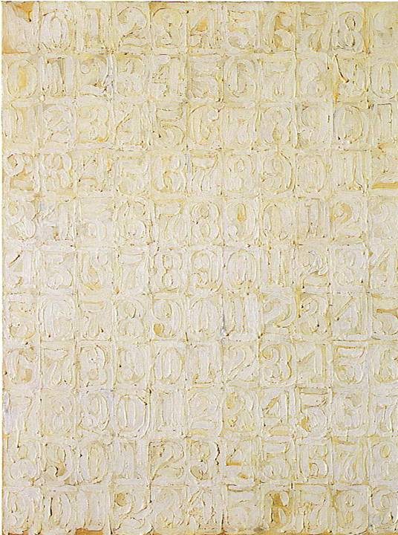
White Numbers, 1958

Slide 4
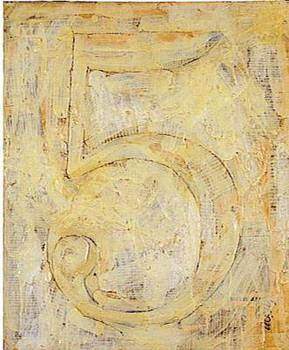
Figure 5, 1955

Slide 5
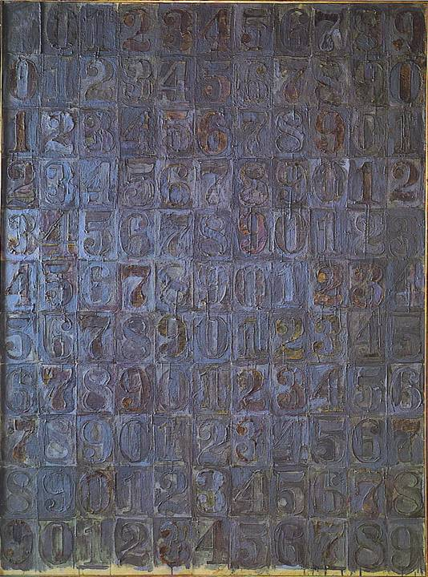
Gray Numbers, 1958

Slide 6
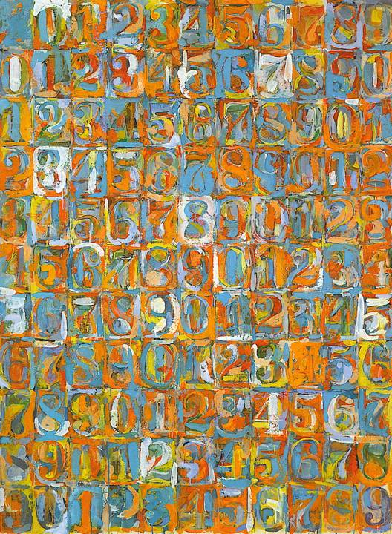
Numbers in Color, 1958 - 59

Slide 7
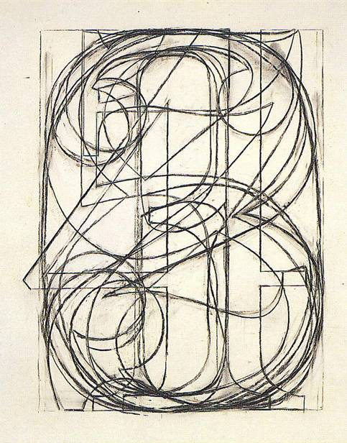

0 through 9, 1960
0 through 9, 1960

Slide 8
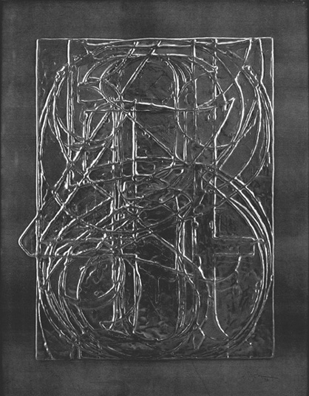
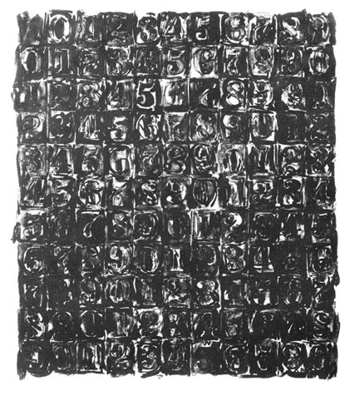
Jasper Johns 0 Through 9, 1970 Embossed lead relief
Jasper Johns Numbers, 1967 Lithograph on Angoumois paper

Slide 9
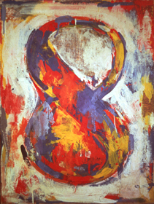
Figure 8, 1959

Slide 10
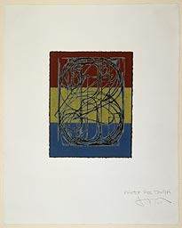

Slide 11
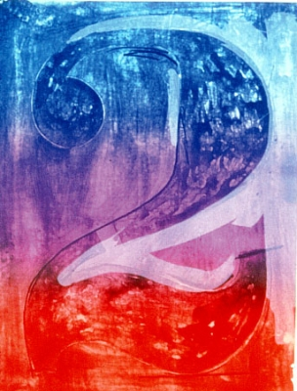
Jasper Johns
(American, b. 1930) Color Numeral, Figure 2, 1969 Lithograph on paper

Slide 12
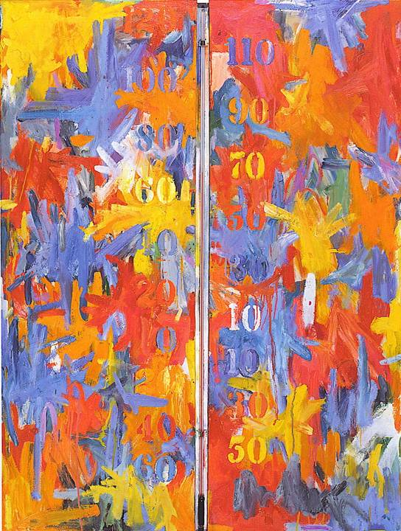
Thermometer, 1959

Slide 13
